Slide 1


The Machine Learning Problem

Slide 2
Outline
The Machine Learning Problem
Type of Machine Learning
Simple Polynomial Curve Fitting
Tools and Frameworks
Homework #1 :

Slide 3
The Learning Problem
Automatic discovery of regularities in data through computer algorithms and the use of those regularities to take actions such as classifying the data into categories.
The Essence of Machine Learning:
A pattern exists
We cannot pin it down mathematically (no analytical solution)
We have data on it
Initial: Problems that hard for human – but easy for computer.
Current: Problems that hard for computer– but easy for human.

Slide 4
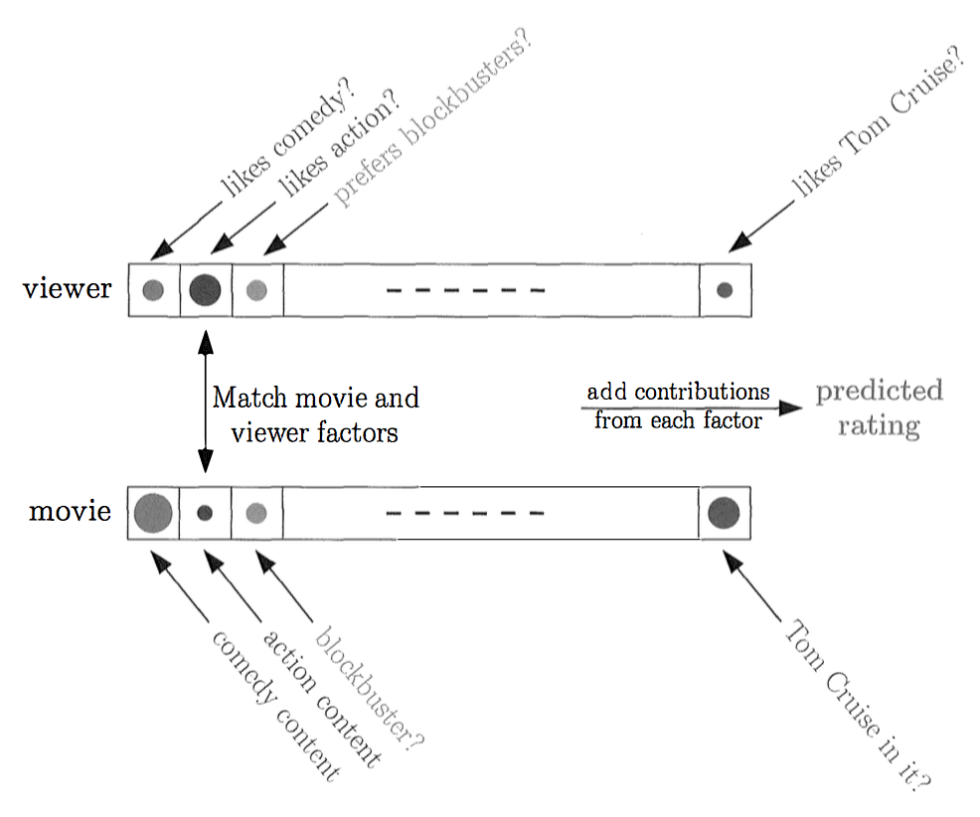
Example: Netflix
Problem
Predict users rating
No information about users and movies
Dataset
100,480,507 ratings, 480,189 users, 17,770 movies
Training Data: <user, movie, data of grade, grade>
Test Data 2,817,131: <user, movie, data of grade, ?>

Slide 5
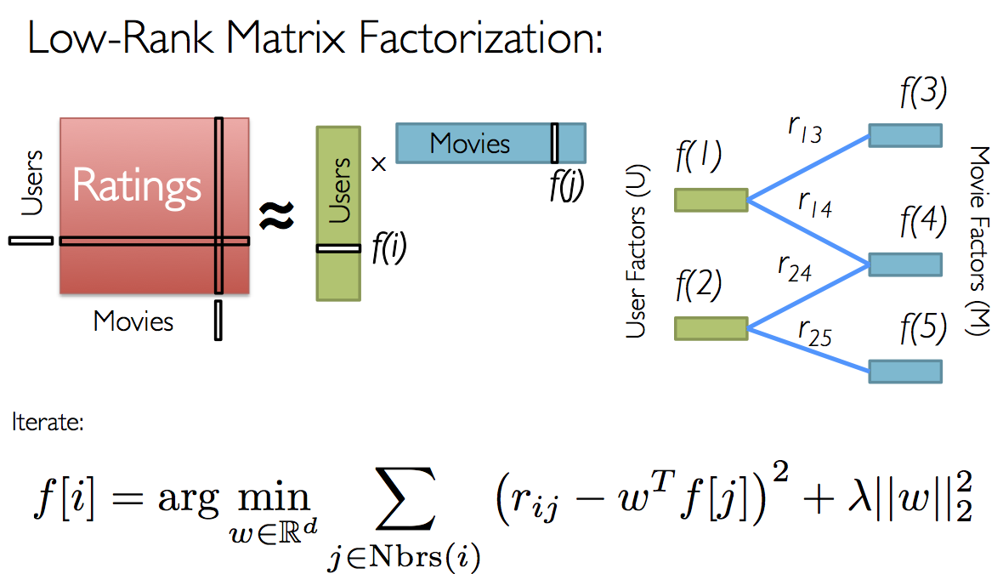
Example: Netflix
Common Techniques:
Collaborative Filtering
Matrix Factorization
Random Initialization
Iteration to Minimize Error
Alternating Least Squares

Slide 6

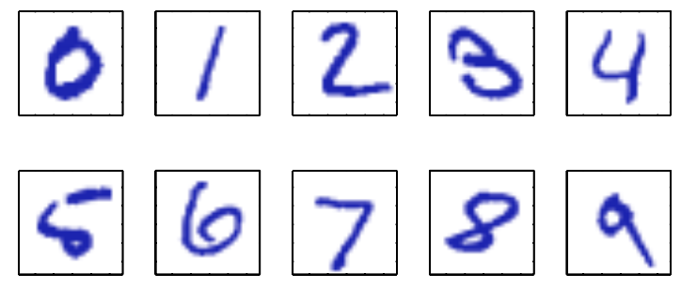

Example: MNIST
Task
Classify handwritten digits
Build a machine that take x input and produce digit identity 0,..9.
Dataset
MNIST: http://yann.lecun.com/exdb/mnist/

Slide 7
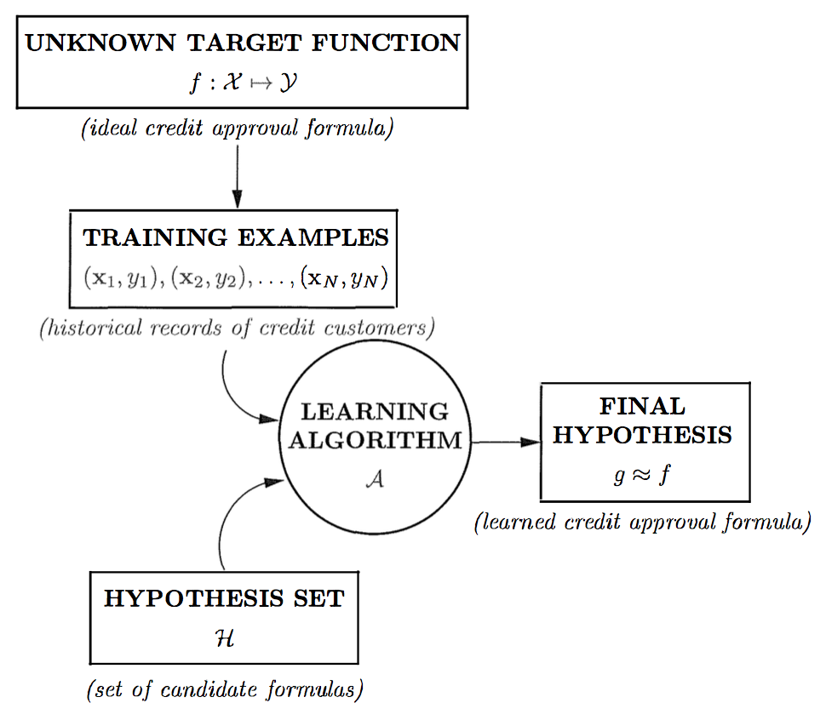
Component of Learning
Metaphor: Credit Card Approval
Input: x (customer application)
Output: y (good/bad customer)
Unknown Target Function f
Data (historical record of credit customers)
Hypothesis Set & Final Hypothesis
Learning Model = Hypothesis Set + Learning Algorithm

Slide 8



Machine Learning Paradigm
Supervised Learning: Learning by labeled example
E.g. An email spam detector
We have (input, correct output), and we can predict (new input, predicted output)
Amazingly effective if you have lots of data
Unsupervised Learning: Discovering Patterns
E.g. Data clustering
Instead of (input, correct output), we get (input, ?)
Difficult in practices but useful if we lack labeled data
Reinforcement Learning: Feedback & Error
E.g. Learning to play chess
Instead of (input, correct output), we get (input, only some output, grade of this output)
Works well in some domains, becoming more important

Slide 9

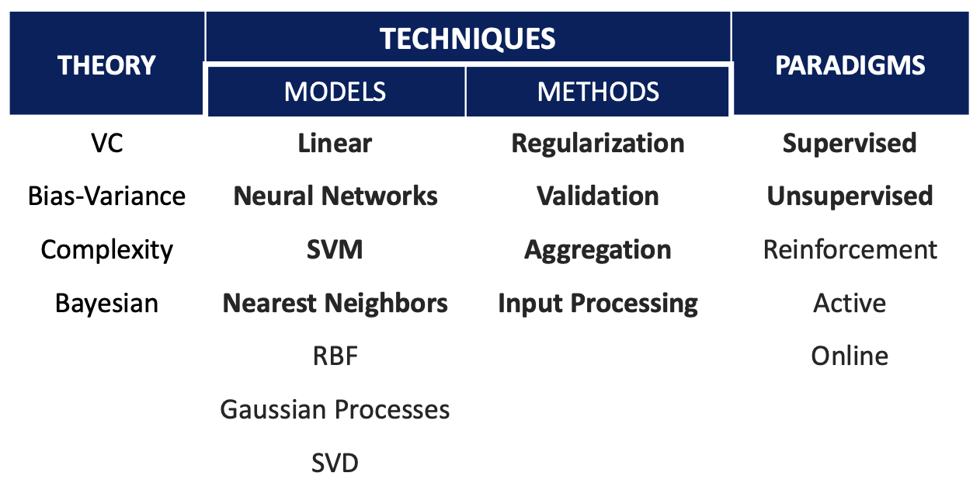
The Landscape
Theory is Required to Guide Engineering
Model = Hypothesis Set + Algorithm
Methods = How to make it works well
Paradigms = The way we see ML problems

Slide 10
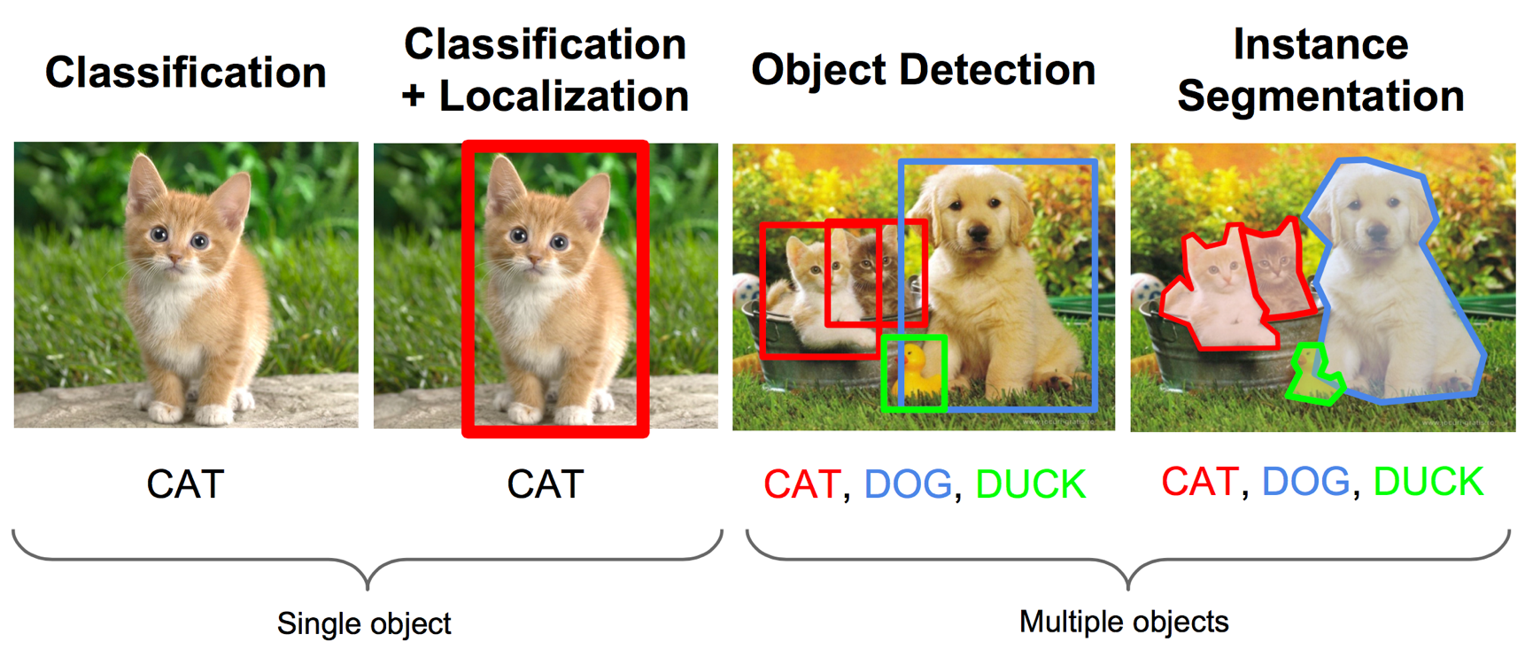
Computer Vision Problem
Data: Images, Videos
Pattern: Spatial
Tasks: Many….

Slide 11
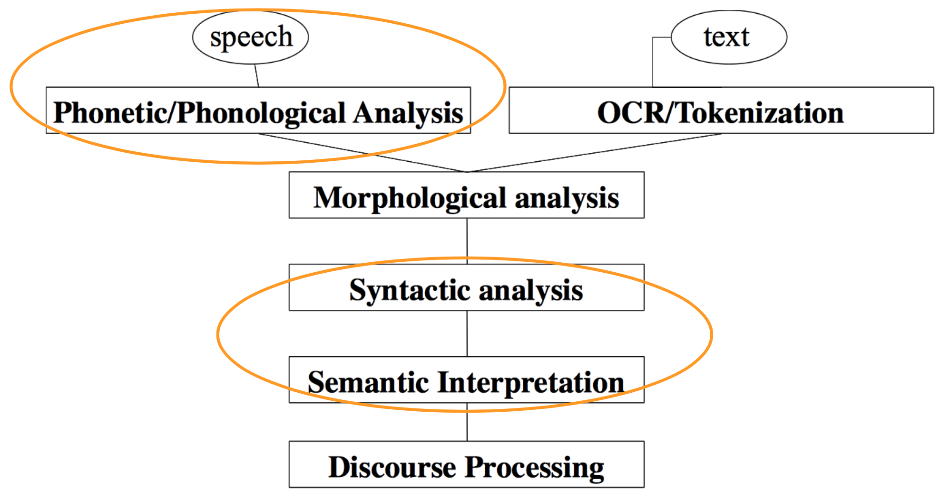
Natural Language Processing Problem
Data: Speech, Texts
Pattern: Sequential
Tasks: Many …

Slide 12
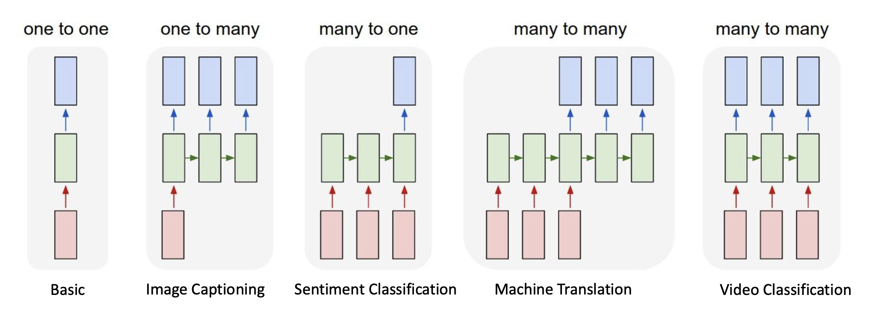
Sequence to Sequence Problem
Data: Texts, Speech
Pattern: Sequential
Tasks: Many …

Slide 13
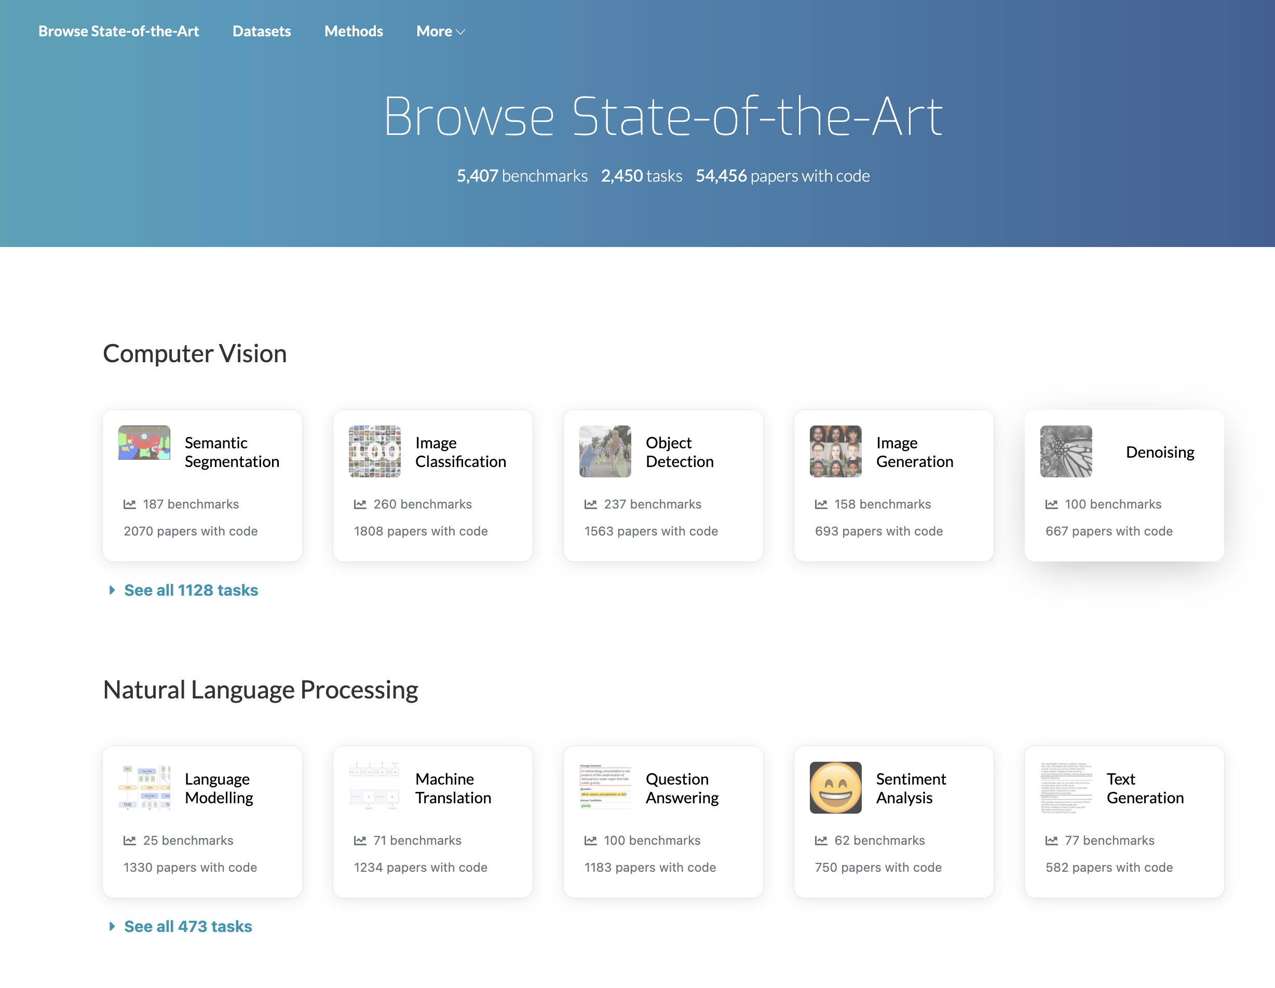
PapersWithCode

Slide 14
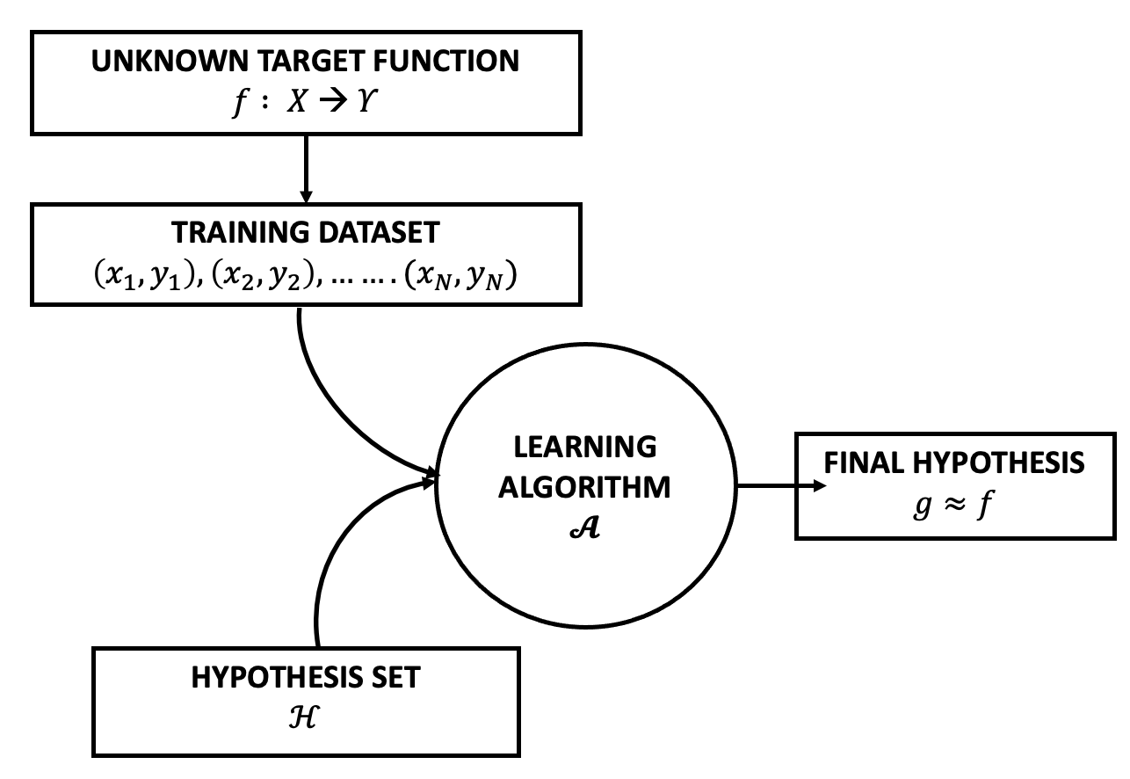
Thinking Framework
Discriminative Supervised Learning:
Problem: Estimate “unknown” function that maps data to labels
This Problem is Translated to:
Classification – If Labels are Categorical
Regression – If Labels are Continous
Approach: Make hypothesis set that potentially has an approximated solution
Technique: Use algorithm to find an approximated function

Slide 15
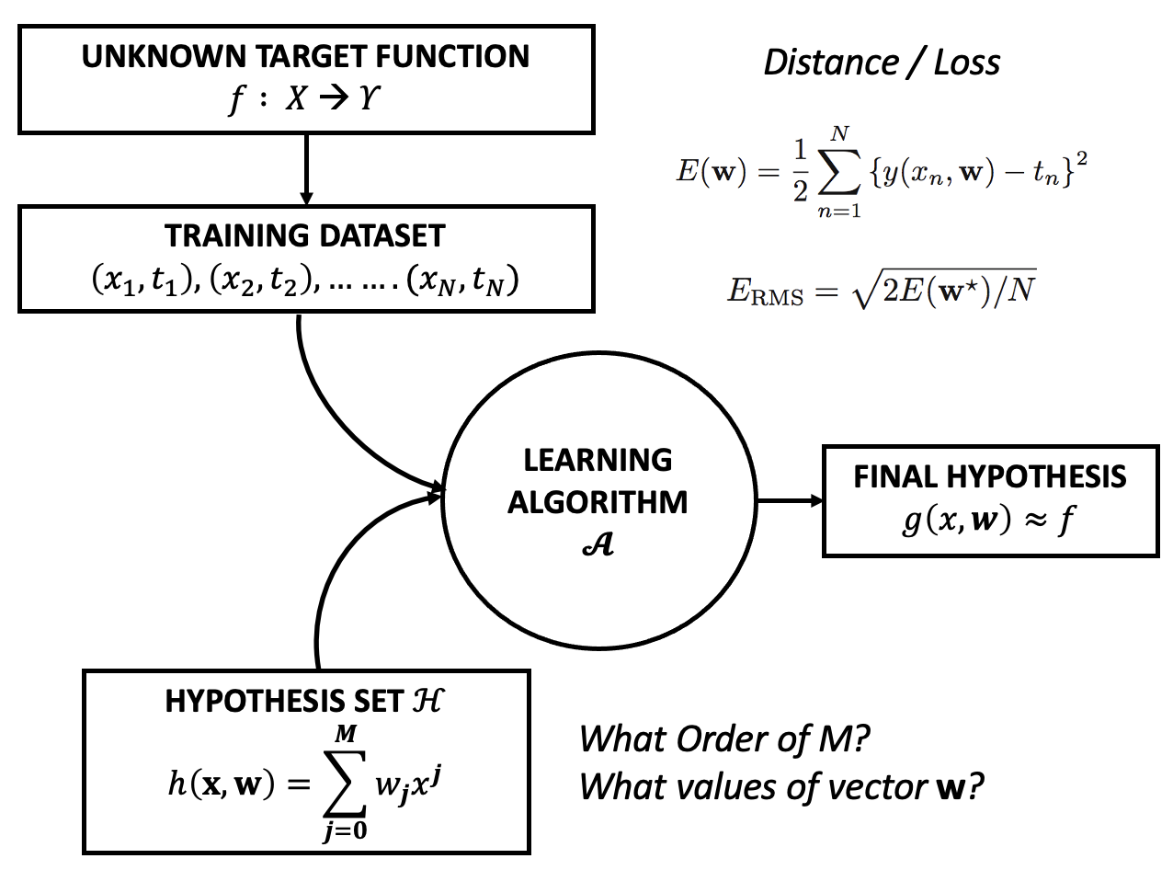
Polynomial Curve Fitting
Simple Regression Problem
Linear Model – Polynomial
Goal: Good Generalization
Learning Algorithms
Minimize Square Error Function E with GD
Or Minimize Root Mean Square (RMS)

Slide 16
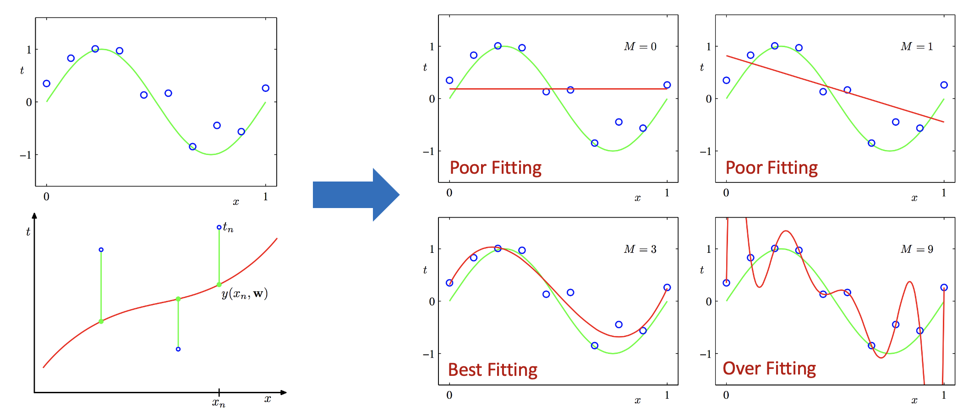
Polynomial Curve Fitting

Slide 17
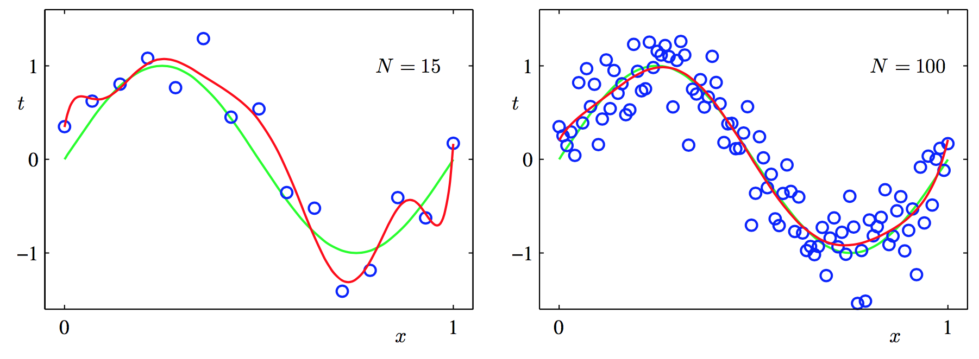

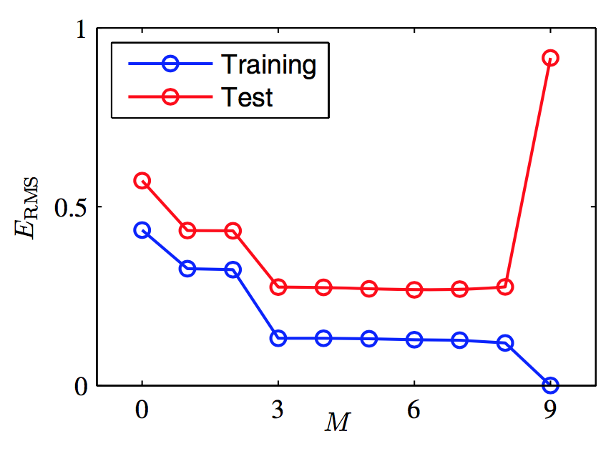
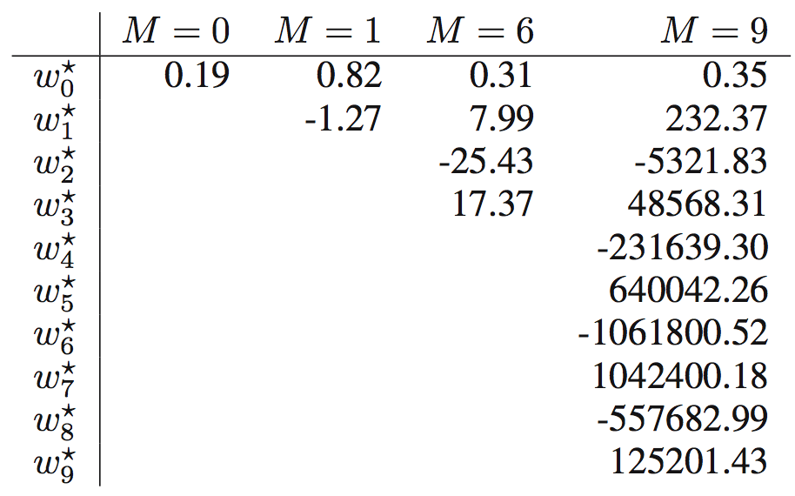
Polynomial Curve Fitting

Slide 18
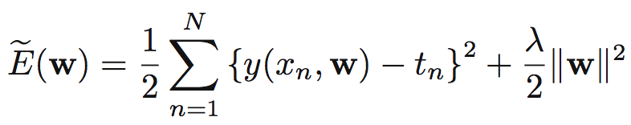
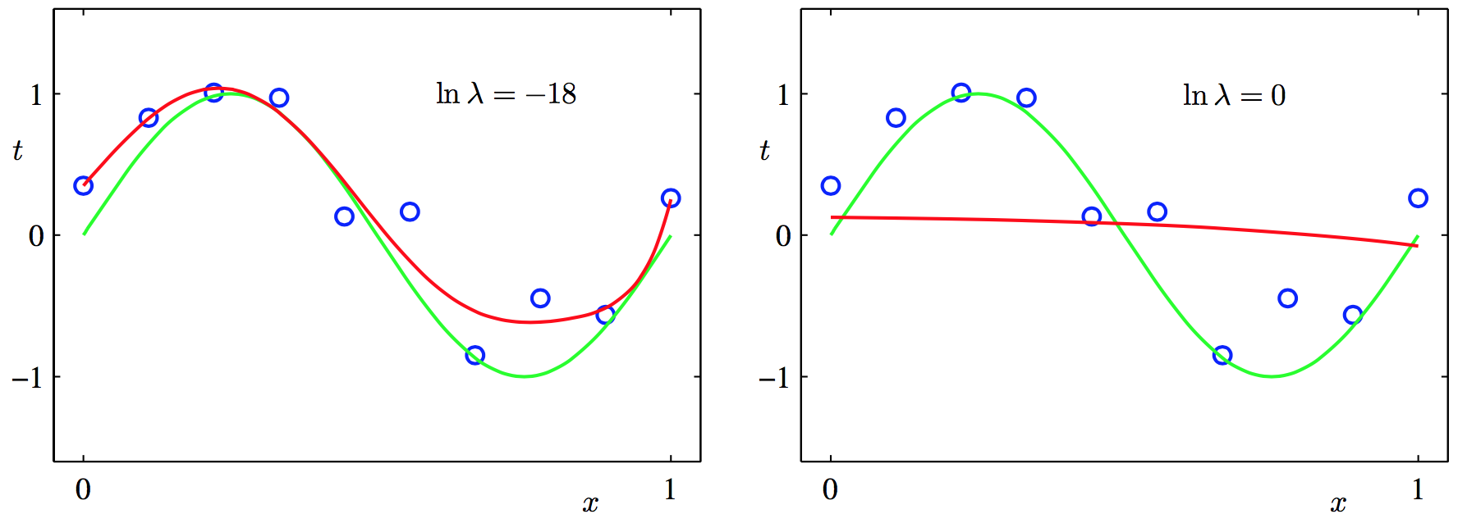
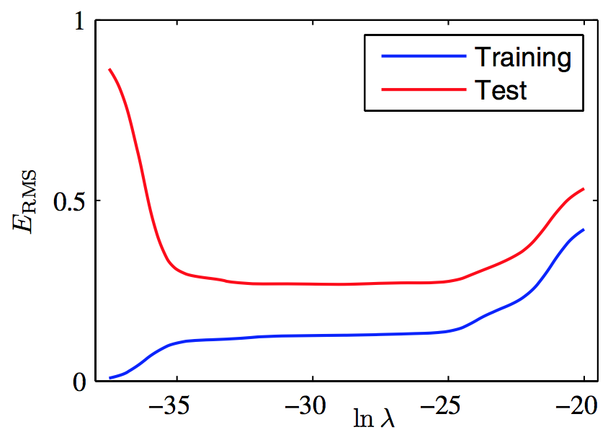
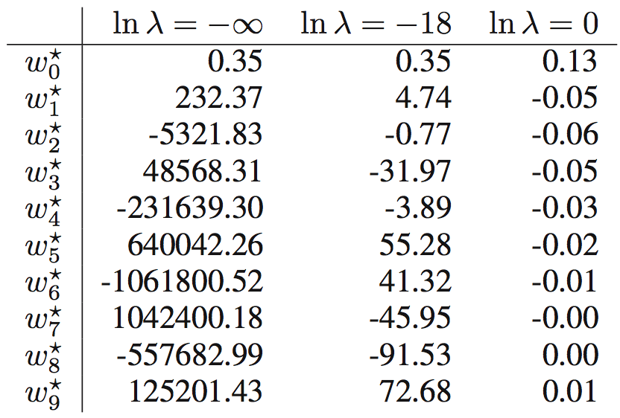
Polynomial Curve Fitting
Regularization for Overfitting
Penalty Term to E to Regulate Value of Parameters
Quadratic Regularizer = Ridge Regression
M=9
M=9

Slide 19



Tools and Frameworks
We Will Use Scikit-Learn Framework & Collab
Simple and Efficient ML Tools (Complete?)
Important Lib: Pandas, NumPy, and Matplotlib
Data Preprocessing with Scikit-Learn:
Standardization, or Mean Removal and Variance Scaling
Non-linear Transformation
Normalization
Binarization
Encoding Categorical Features
Imputation of Missing Values
Generating Polynomial Features
Custom Transformers

Slide 20
OBE HW: House Prediction
Watching Youtube:
Decision Tree: https://www.youtube.com/watch?v=_L39rN6gz7Y
Random Forests: https://www.youtube.com/watch?v=J4Wdy0Wc_xQ
Hacking The Codes: https://www.kaggle.com/learn/intro-to-mac
How Models Work
Basic Data Exploration
Decision Tree Model
Model Validation
Underfitting and Overfitting
Random Forest

